Slide 1
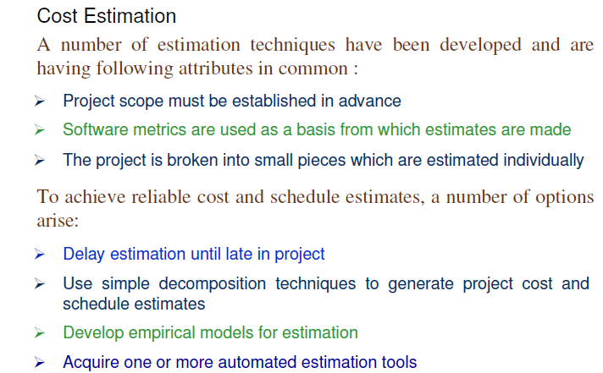
SOFTWARE ENGINEERING
Dr Prabhat Kumar Vishwakarma

Slide 2
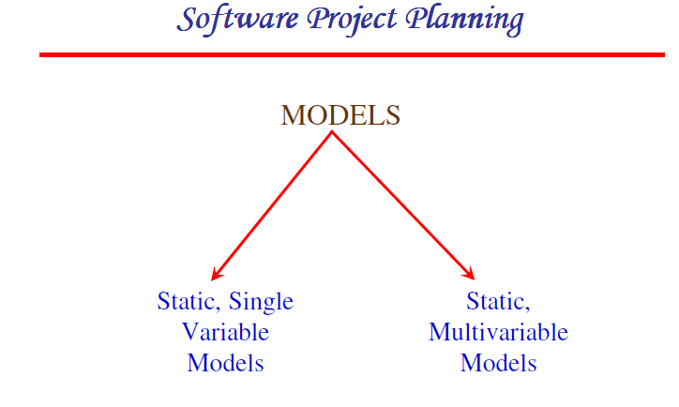
SOFTWARE ENGINEERING
Dr Prabhat Kumar Vishwakarma

Slide 3
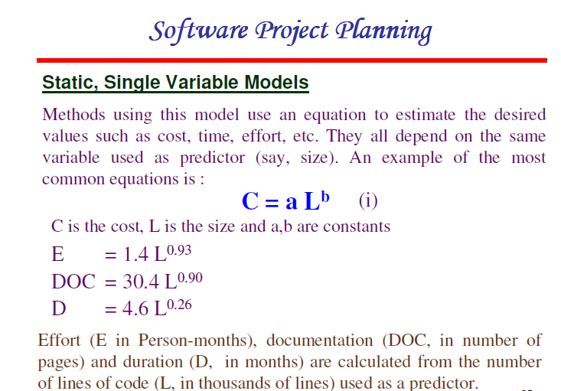
SOFTWARE ENGINEERING
Dr Prabhat Kumar Vishwakarma

Slide 4
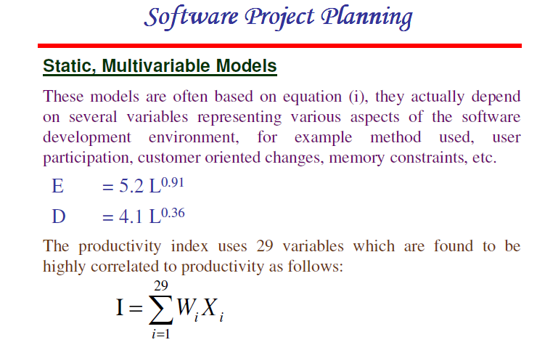
SOFTWARE ENGINEERING
Dr Prabhat Kumar Vishwakarma

Slide 5
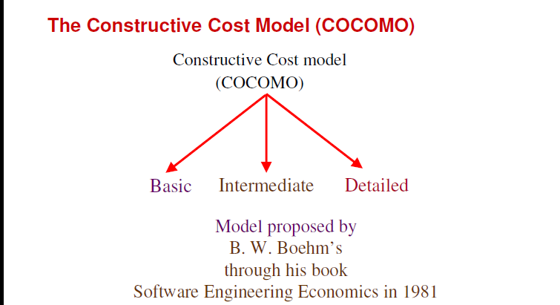
SOFTWARE ENGINEERING
Dr Prabhat Kumar Vishwakarma

Slide 6
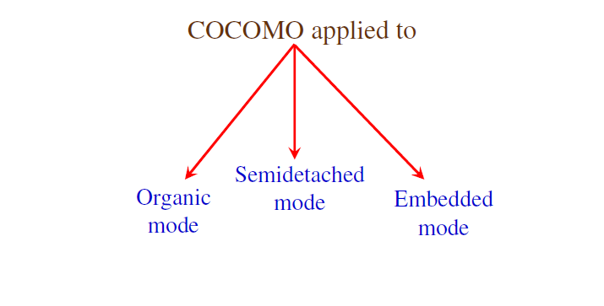
SOFTWARE ENGINEERING
Dr Prabhat Kumar Vishwakarma

Slide 7
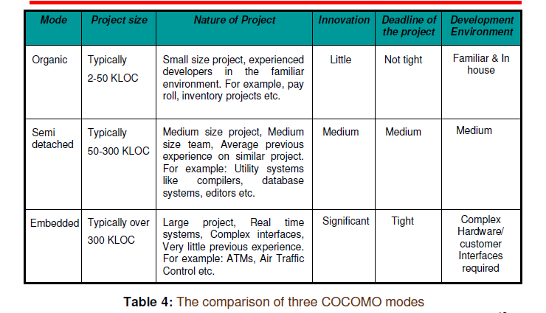
SOFTWARE ENGINEERING
Dr Prabhat Kumar Vishwakarma

Slide 8
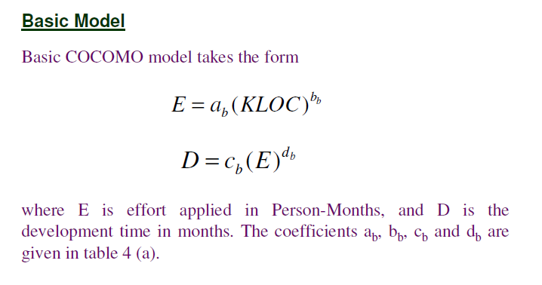
SOFTWARE ENGINEERING
Dr Prabhat Kumar Vishwakarma

Slide 9
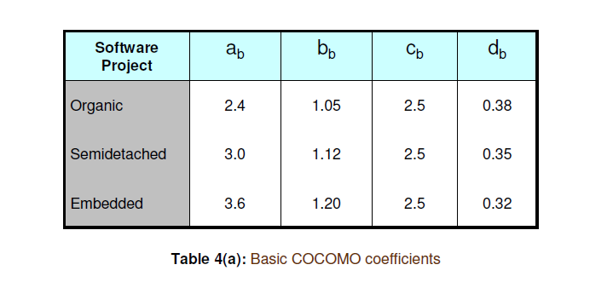
SOFTWARE ENGINEERING
Dr Prabhat Kumar Vishwakarma

Slide 10
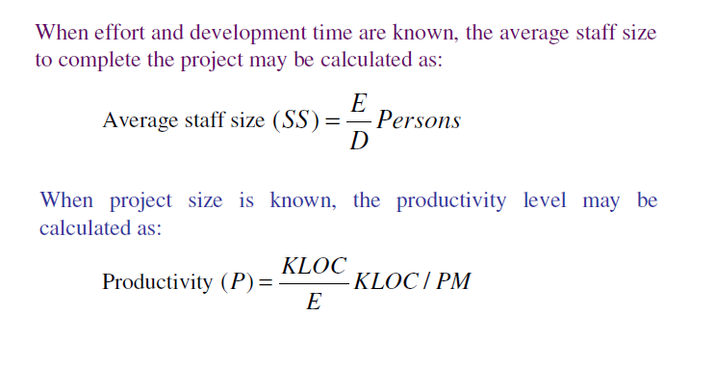
SOFTWARE ENGINEERING
Dr Prabhat Kumar Vishwakarma

Slide 11
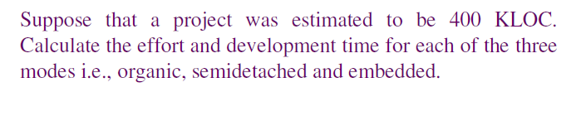
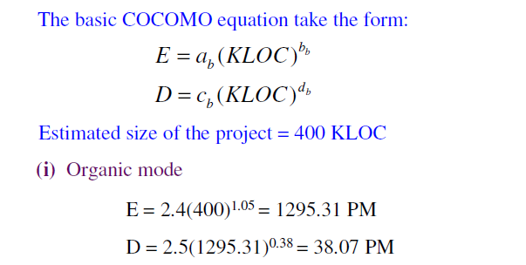
SOFTWARE ENGINEERING
Dr Prabhat Kumar Vishwakarma

Slide 12
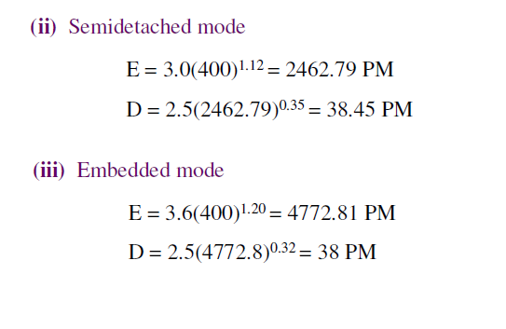
SOFTWARE ENGINEERING
Dr Prabhat Kumar Vishwakarma

Slide 13
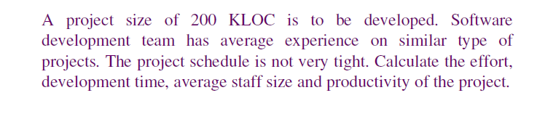
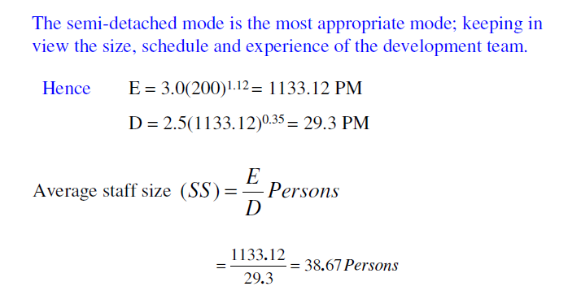
SOFTWARE ENGINEERING
Dr Prabhat Kumar Vishwakarma

Slide 14
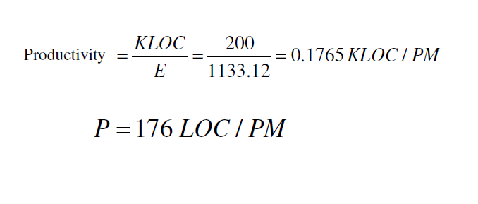
SOFTWARE ENGINEERING
Dr Prabhat Kumar Vishwakarma

